Slide 2
Increase your .NET Productivity with Visual Studio 2019
Mika Dumont
Kendra Havens

Slide 3
Outline
Live Share
Code fixes and refactorings
Analyzers
Code cleanup and EditorConfig
Code analysis project properties
IntelliCode
Test Explorer
Preview features

Slide 4
Live Share

Slide 5
Live Share
Collaborative co-editing
Co-debugging
No environment set-up for the guest
Up to 5 guests
Read/write access
Shared terminal
Shared servers

Slide 6
Code fixes and refactorings

Slide 7
Code fixes and refactorings
Sync namespace and folder name
Completion for unimported types
Generate parameter
Toggle single line comment or block comment
Split/Merge if statements
Wrap binary expressions, arguments, and call chains
Sort usings is back!
Usings inside/outside a namespace

Slide 8
Analyzers

Slide 9
EditorConfig and Code cleanup

Slide 10
Code analysis project properties

Slide 11
IntelliCode

Slide 12
Test Explorer

Slide 13
Preview Features

Slide 14
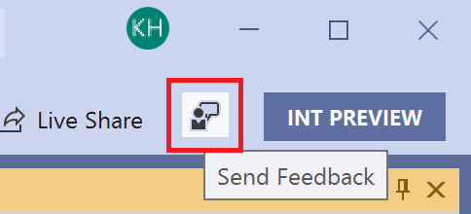
Resources
File bugs on https://developercommunity.visualstudio.com
or directly from Visual Studio!
Docs: https://aka.ms/refactor
Our open source GitHub repo:
https://aka.ms/roslyn

